Slide 1
The World of NoSQL Databases

Slide 2
Agenda
At the end of this session, you will be able to understand
What is a NoSQL Database
Difference between SQL and NoSQL databases
MongoDB and its use case
Cassandra and its use case
HBase and its use case
Neo4J and its use case
Hands-On - MongoDB Blog Application

Slide 3
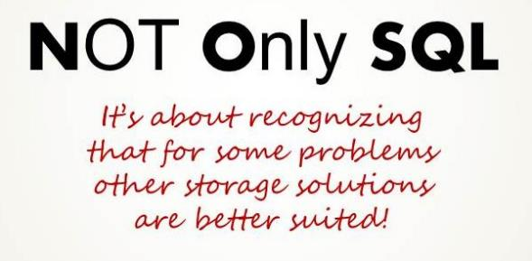
What is NoSQL?
NoSQL Stands for Not Only SQL
NoSQL is a class of non-relational data storage systems
NoSQLs are designed to handle large volume of data, high availability and superior performance

Slide 4
SQL vs. NoSQL Comparison
Entity | SQL Databases | NoSQL Databases
Type | One Type (SQL) with Minor Variation | Many Types (Document, Key-Value, Tabular, Graph)
Development | 1970 | 2000
Examples | Oracle, MSSQL, DB2 etc. | MongoDB, Cassandra, Hbase, Neo4J
Schemas | Fixed | Dynamic
Scaling | Vertical | Horizontal
Dev Model | Mix | Open Source
Consistency | Follow ACID | Follow BASE

Slide 5
Why NoSQL?
Following 4 points best describes why NoSQL databases are required
Complexity
Variety
Volume
Velocity

Slide 6
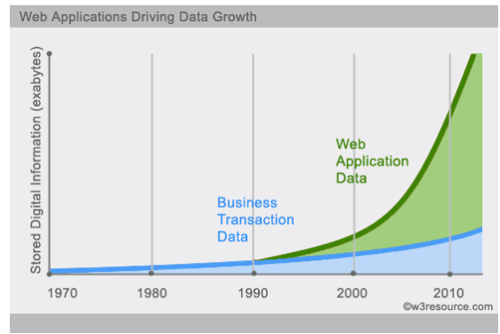
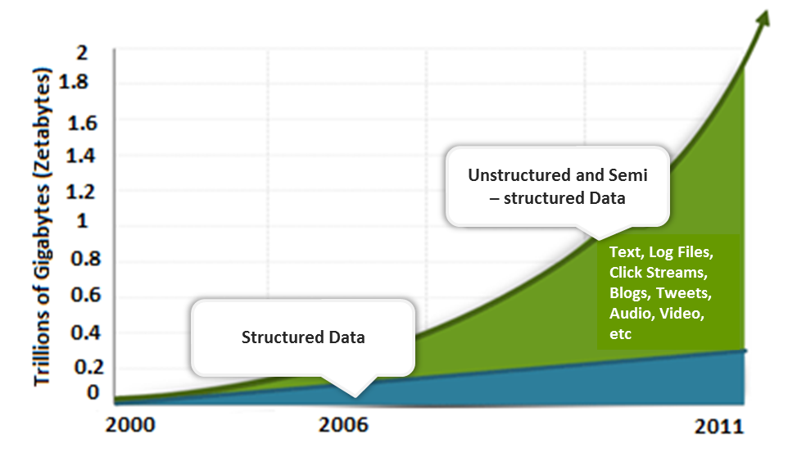
Why NoSQL? (Contd.)
Data is increasing like never before

Slide 7
Categories of NoSQL Database
Document Base
Key – value Stores
Document databases pair each key with a complex data structure known as a document.
Key-value stores are the simplest NoSQL databases.
Graph Store
Wide Column Stores
Graph stores are used to store information about networks, such as social connections.
Wide-column stores such as Cassandra and HBase are optimized for queries over large datasets.

Slide 8
Type of NoSQL Databases
Key Value Store
Memcached
HBase
Tabular
Big Table
Hypertable
Redis
Cassandra
Document Oriented
MongoDB
Couch DB
Cloudant
Graph Stores
HyperGraphDB
Neo4J
Oracle NoSQL

Slide 9
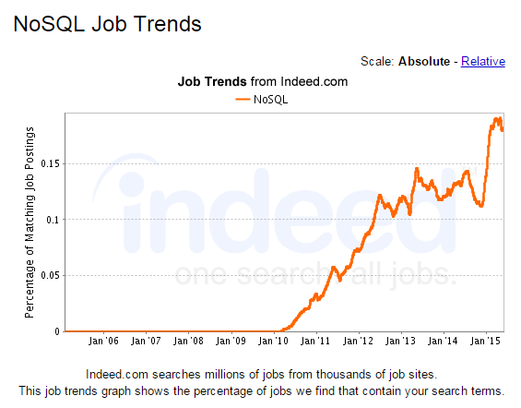
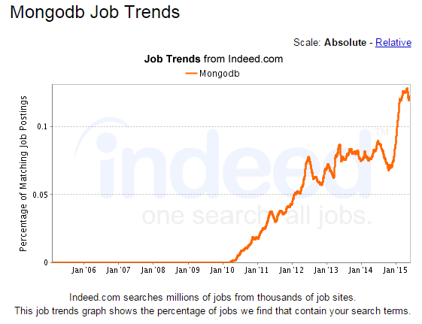
NoSQL Job Trends

Slide 10
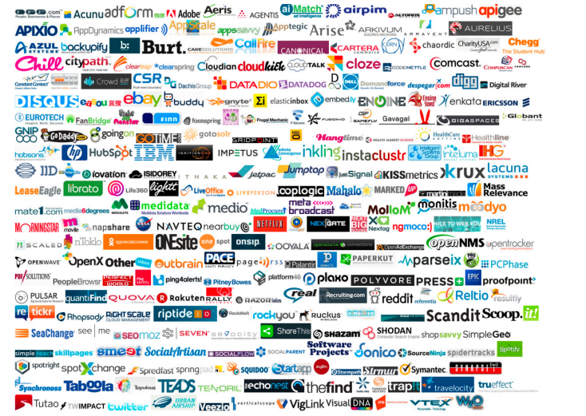
Who uses NoSQL
Below are some of the companies that use NoSQL databases

Slide 11

MongoDB
MongoDB is an Open-source document based database
Developed by 10gen, for a wide variety of applications. Now it is named as MongoDB
It is an agile database that allows schemas to change quickly as applications evolve
Scalability, High Performance and Availability
Leverages in-memory computing
MongoDB’s native replication and automated failover enable enterprise-grade reliability and operational flexibility

Slide 12
MongoDB Features
Drivers: 13
MongoDB-Supported Drivers; 37 Community-Supported
Drivers
Hadoop
Integration
JSON Data
Model with
Dynamic
Schemas
MongoDB
Features
Aggregation Framework
Auto-Sharding
Built-In Replication for High Availability
Rich Secondary Indexes,
Including
Geospatial and
TTL indexes

Slide 13




















Few MongoDB Clients
US Department of
Veterans Affairs
US Department of
Energy’s Berkley Lab and MIT

Slide 14





Few MongoDB Clients (Contd.)
 | Metlife uses MongoDB for “The Wall” an innovative customer service application provides a 360-degree, consolidated view of MetLife customers, including policy details and transactions across lines of business.
 | ebay has a number of projects running on MongoDB for search suggestions, metadata storage, cloud management and merchandizing categorization.
 | MongoDB is the repository that powers MTV Networks’ next-generation CMS, which is used to manage and distribute content for all of MTV Networks’ major websites.
 | MongoDB is used for back-end storage on the SourceForge front pages, project pages, and download pages for all projects.
 | Craigslist uses MongoDB to archive billions of records.
 | ADP uses MongoDB for its high performance, scalability, reliability and its ability to preserve the data manipulation capabilities of traditional relational databases.

Slide 15




Few MongoDB Clients (Contd.)
 | CNN Turk uses MongoDB for its infrastructure and content management system, including the tv.cnnturk.com.
 | Foursquare uses MongoDB to store venues and user ‘check-ins’ into venues, sharding the data over more than 25 machines on Amazon EC2.
 | Justin.tv is the easy, fun, and fast way to share live video online. MongoDB powers Justin.tv’s internal analytics tools for virality, user retention, and general usage stats that out-of-the-box solutions can’t provide.
 | ibibo (‘I build, I bond’) is a social network using MongoDB for its dashboard feeds. Each feed is represented as a single document containing an average of 1000 entries; the site currently stores over two million of these documents in MongoDB.

Slide 16

Apache Cassandra
Apache Cassandra is a distributed NoSQL database born at facebook and built on Amazon’s Dynamo and Google’s BigTable

Slide 17
Apache Cassandra Features
Column Oriented key-value store
Hadoop
Integration
High Performance
Cassandra
Features
Elastic Scalability
High Availability
Fault Tolerance
CQL

Slide 18






Cassandra at work
Below are some of the companies that have deployed and benefited from Cassandra

Slide 19
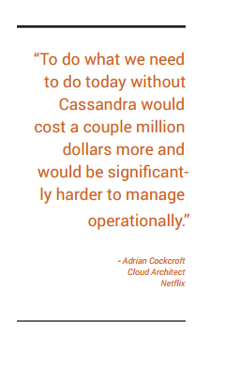
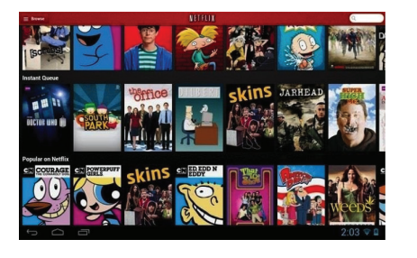
Cassandra at Netflix
Netflix tailors content delivery based on data captured and analyzed in Cassandra
Netflix delivers personalized content

Slide 20

HBase
HBase is a non-relational (NoSQL) database which stores data in key-value pair. Specifically it is:
Distributed
Multi- dimensional
Sparse
Consistent
Sorted
Map

Slide 21
When to use HBase?
Unstructured
data
High volume data to be stored
High scalability
Uses
of
HBase
Column-oriented
data
Versioned
data
Generating data from an MapReduce work flow

Slide 22

Facebook Messaging System
Facebook monitored their usage and figured out what they really needed.
What they needed was a system that could handle two types of data patterns:
A short set of temporal data that tends to be volatile
An ever-growing set of data that rarely gets accessed
Real Time
Linearly
Key Value
Big Data
Column-Oriented
Scalable
Distributed
Robust
Open source

Slide 23





HBase at work
A number of applications including people search rely on HBase internally for data generation.
Uses HBase to power their Messages infrastructure
Uses HBase as a real time data storage and analytics platform.
Uses HBase to store document fingerprint for detecting near-duplications
Uses an HBase cluster containing over a billion anonymized clinical records.
Uses HBase as a foundation for cloud scale storage for a variety of applications.
Source - http://wiki.apache.org/hadoop/Hbase/PoweredBy

Slide 24
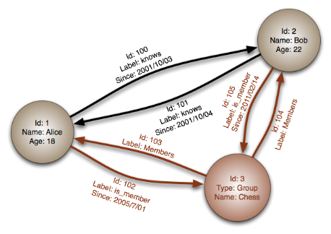
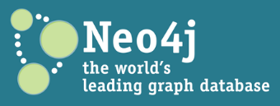
Neo4J
Neo4J is an open source graph database by Neo Technology. Neo4j stores data as nodes connected by relationships

Slide 25

Neo4J at work
From fortune 500 companies to startups, Neo4J powers innovative solutions across a wide range of industries. Some of them are listed below

Slide 26

Neo4J at Zepher Health
Challenge
Enable end users to “be their own data scientist”
Develop an easy-to-use Cloud-based engine to mine data from disparate sources
Solution
New architecture leveraging Neo4j and MongoDB for BI reporting
Result
High-speed, scalable complex analytics platform
Supports traversals with 16 intersections (hops) in under 200ms

Slide 27

Hands-On
MongoDB Blog Application

Slide 28
Questions

